Slide 1
Superscalar CPU and multicore systems
Pavel Kryukov
08/12/2017

Slide 2
Refresher: Basic Design Tradeoffs
Performance
(speed)
Cost
(complexity, area)
Power
(energy consumption and dissipation)
All three are very important
It is extremely hard to create a feature that improves all factors
Different products (mobile, desktop, etc.) require different balance

Slide 3
Pt. I: Performance

Slide 4
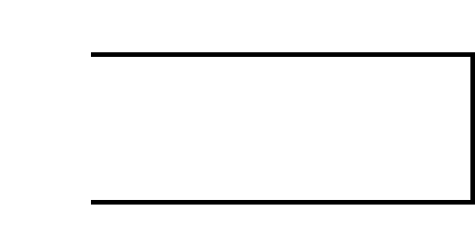
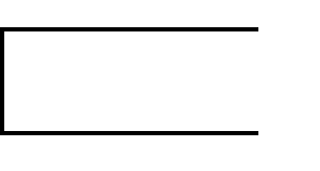
Performance
What does performance depend on?
$$Performance= \frac{1}{Time}$$
$$= \frac{1}{N_{instrs}∗CPI∗T_{cycle}}$$
$$= \frac{1}{N_{instrs}}∗IPC∗f$$
$$Time=Cycles∗T_{cycle}$$
$$=N_{instrs}∗CPI∗T_{cycle}$$
Golden rule of CS

Slide 5
Increasing Performance
How can we increase it?
Better SW: algorithms, optimizations, ISA, etc.
Better CD: faster circuits, smaller transistors, etc.
$$Performace= \frac{1}{N_{instrs}}∗IPC∗f$$
Better uArch: pipelining, caching, prediction, etc.
But, need better CD to enable these approaches
(e.g., more transistors)

Slide 6
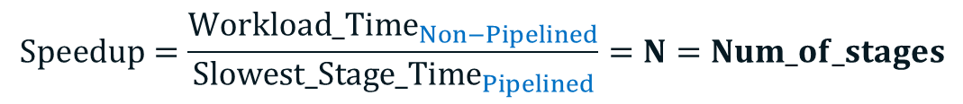
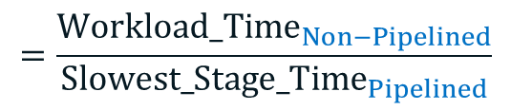
Refresher: Pipeline speedup
Pipelining does not reduce the latency of a single workload, it increases the total throughput (number of completed workload per time unit)
Pipeline throughput(=rate) is limited by the slowest stage
Potential speedup is:
$Speedup= \frac{{Throughput}_{Non−Pipelined}}{{Throughput}_{Pipelined}}$
In ideal case, all stages have the same length:
$$=\frac{{Workload_Time}_{Non−Pipelined}}{{Slowest_Stage_Time}_{Pipelined}}$$
$$Speedup=\frac{{Workload_Time}_{Non−Pipelined}}{{Slowest_Stage_Time}_{Pipelined}}=N=Num_of_stages$$

Slide 7
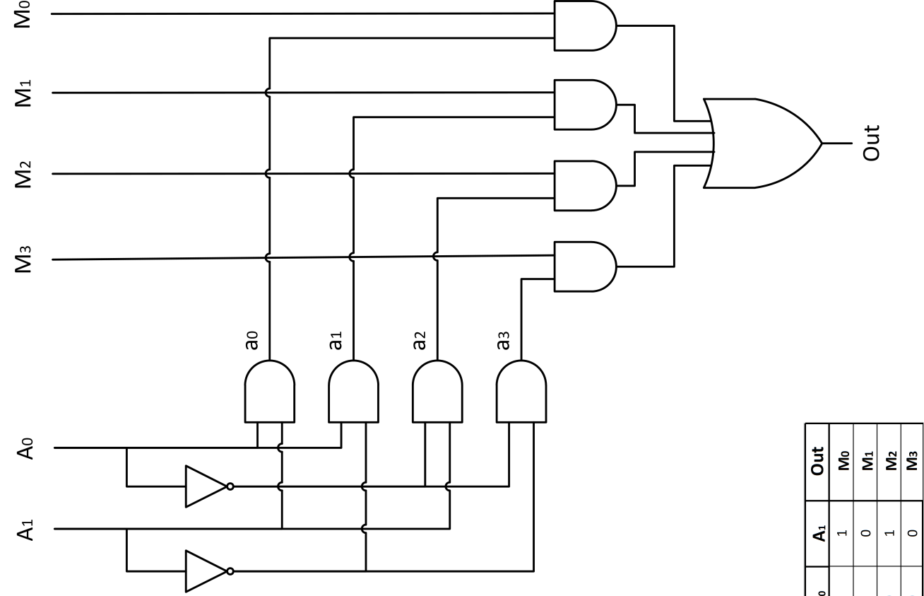
Ways to increase speedup
Partition the pipe to many pipe stages
Balance the work in the pipe stages: make the longest pipe stage to be as short as possible
Latches increase overall latency

Slide 8
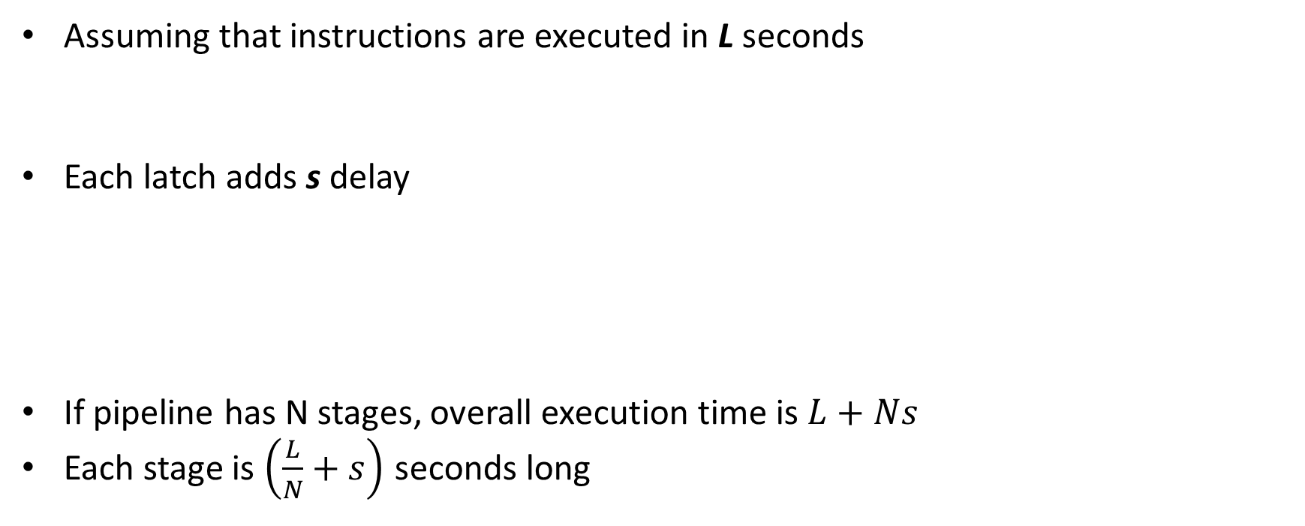
Pipeline Timing Model
Assuming that instructions are executed in L seconds
Each latch adds s delay
If pipeline has N stages, overall execution time is $L+Ns$
Each stage is $\left(\frac{L}{N}+s\right)$ seconds long
s
F
L
D
E
M
W
s
L/2
s
L/2
= L + 2s
s
L/3
s
L/3
s
L/3
= L + 3s

Slide 9
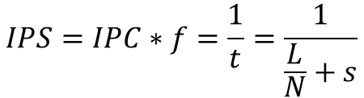

Performance with Latches
Every cycle is $t=\left(\frac{L}{N}+s\right)$ long
In ideal case, IPC = 1 for pipeline
Performance is
Infinite performance is impossible
The best result is achieved if cycle contains nothing but latches
$$IPS=IPC∗f=\frac{1}{t}=\frac{1}{\frac{L}{N}+s}$$
$$\lim_{N→∞}{IPS(N)}=\frac{1}{s}$$
$$\lim_{N→∞}{t(N)}=s$$

Slide 10



Improving model: adding BTB Impact
Branch mispredicts stall some fraction (γ) of pipeline
Since they are rare, in average CPI delta is lower:
In general, “alpha” parameter is a function of selected uArch:
how good branches are predicted;
how mispredicts affect pipeline;
bypassing levels;
cache hit rate, out-of-order effects etc.
$$∆CPI=γN$$
$$\overline{∆CPI}=βγN=αN$$
$$\overline{CPI}=1+αN$$

Slide 11
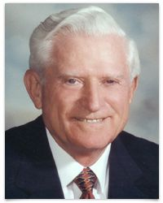
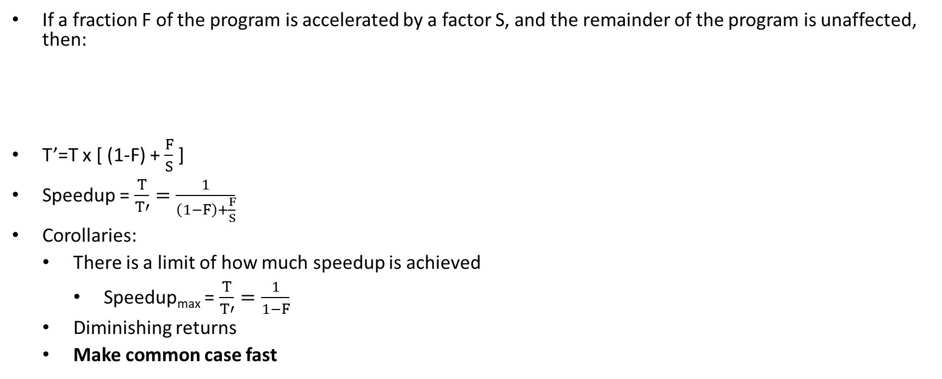
Amdahl’s Law
If a fraction F of the program is accelerated by a factor S, and the remainder of the program is unaffected, then:
T’=T x [ (1-F) + $\frac{F}{S}$ ]
Speedup = $\frac{T}{T′}=\frac{1}{\left(1−F\right)+\frac{F}{S}}$
Corollaries:
There is a limit of how much speedup is achieved
Speedup_{max} = $\frac{T}{T′}=\frac{1}{1−F}$
Diminishing returns
Make common case fast
T
T’

Slide 12
Examples of Amhdal’s Law
Assuming branch prediction accuracy is 50%
20% of instructions are branches
Increasing BPU accuracy to 90%
Improving BPU accuracy by 40% → CPI increase is only 18%
$$\overline{CPI}=1+20\% ∗50\% ∗3=1.3$$
$$\overline{CPI}=1+20\% ∗90\% ∗3=1.54=1.3 ∗(100\%+18\%)$$

Slide 13
Refresher: superscalar processors
Single-cycle and pipelined processors are unified to scalar class as they process 1 instruction in 1 cycle
Superscalar CPU processes 2 or more instructions in each cycle with additional, extracting ILP (inpipelinestruction level-parallelism)
time
4ns
8ns
12ns
16ns
PC
F
D
E
M
W
PC + 4
F
D
E
M
W
PC + 8
F
D
E
M
W
PC + 12
F
D
E
M
W
PC + 16
F
D
E
M
W
PC + 20
F
D
E
M
W

Slide 14
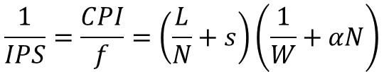

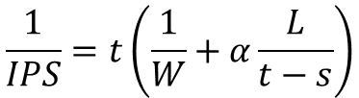
Improving model: adding superscalar
In superscalar CPUs ideal CPI depends on width
Overall, we have an equation for performance
Let’s use clock time for simplicity
$$CPI=\frac{1}{W}+αN$$
$$\frac{1}{IPS}=\frac{CPI}{f}=\left(\frac{L}{N}+s\right)\left(\frac{1}{W}+αN\right)$$
$$\frac{1}{IPS}=t\left(\frac{1}{W}+α\frac{L}{t−s}\right)$$

Slide 15

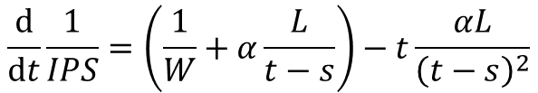
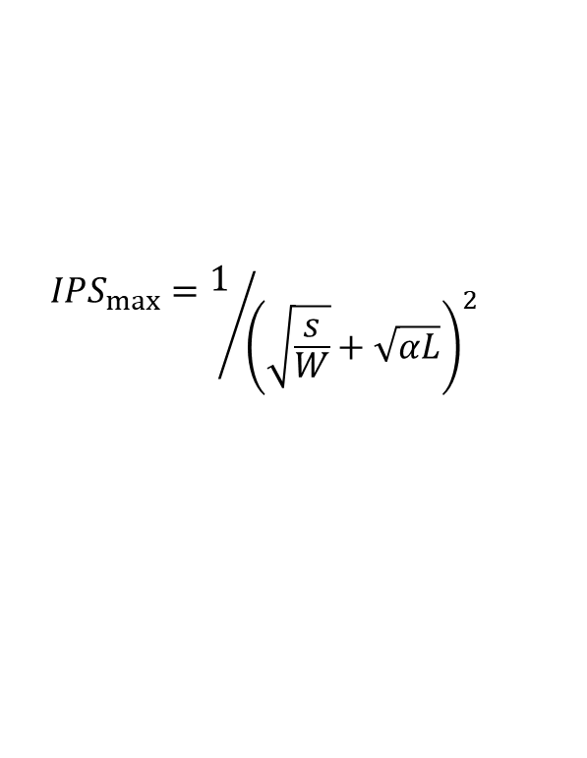
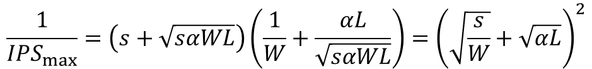
Maximum performance
Performing derivation by t:
Finding maximum performance:
$$\frac{\text{d}}{\text{d}t}\frac{1}{IPS}=\left(\frac{1}{W}+α\frac{L}{t−s}\right)−t\frac{αL}{{\left(t−s\right)}^{2}}$$
$$0=\frac{{(t−s)}^{2}}{W}+αL\left(t−s\right)−tαL⇒t_{opt}=s+\sqrt{sαWL}$$
$$\frac{1}{{IPS}_{max}}=\left(s+\sqrt{sαWL}\right)\left(\frac{1}{W}+\frac{αL}{\sqrt{sαWL}}\right)={\left(\sqrt{\frac{s}{W}}+\sqrt{αL}\right)}^{2}$$
$${IPS}_{max}=1/{{\left(\sqrt{\frac{s}{W}}+\sqrt{αL}\right)}^{2}}$$

Slide 16
Intel CPUs timeline
Prescott P4
What happened?
P4
Pentium Pro
PII
PIII
80386
80486
8086
80286
Pentium

Slide 17
Pt. II: Power

Slide 18
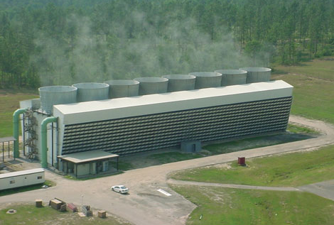
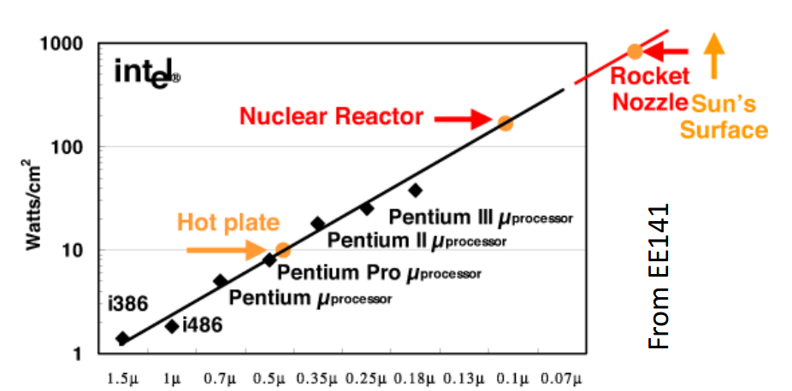
Power
Nuclear reactor? No, power supply for a large data center
Why is power important?
Less power -> smaller battery -> smaller/cheaper devices
Less power -> less money for electricity
Power Wall is reached
The maximum power dissipation that cooling systems can handle is reached
We cannot spend more power even if we want

Slide 19
Power Consumption in CMOS
Vcc
1
Input
Output
No current in static state, i.e. there is no power consumption
Current exists only at switch from one state to another to recharge the capacities
0
Input
1
+
+
0
Source
Gate
Drain
Drain
Gate
Source
1
-
-
n
n
p
p
p
n
No connection between the power supply and the ground
Output
Gate

Slide 20
Recharging Power
$$E_{R}=\frac{CV^{2}}{2}$$
$$E_{C}=\frac{CV^{2}}{2}$$
$$E_{R}=\frac{CV^{2}}{2}$$
$$P=CV^{2}f$$

Slide 21

Dynamic power
Dynamic power in consumed since transistors change state:
Keep in mind that clock signals are included in dynamic power
Some power is lost due to “crowbars”
~80% of consumed power
dynamic capacity
frequency
$$P_{d}=aCV^{2}f$$
average amount of transistors
Voltage
1
0

Slide 22

Static power
Static power is consumed by leakage
Area S depends on:
number of pipeline stages N (more latches required)
issue width W
branch prediction, caches etc. — α
Leakage current j depends on technical process
~20% of consumed power
$$P_{s}=jSV$$
area
leakage current

Slide 23
Performance/Power balance
Depending on market target, we may optimize:
performance (IPS)
power (Watts)
energy = power / IPS (Joules)
dissipation = power / area (Watts / cm²)
New features are added to CPU regarding to select target
Example 1: deeper pipelining increases power consumption:
higher frequency increases dynamic power
new latches increase both static and dynamic power
Example 2: issue width increases power in ~O(W²)

Slide 24

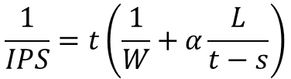
Superscalar is not scalable
Performance increases with width:
Power increases faster:
What shall we do?
$$\frac{1}{IPS}=t\left(\frac{1}{W}+α\frac{L}{t−s}\right)$$
$$P\sim fS\sim \frac{W^{2}L}{t−s}$$

Slide 25
Pt. III: Parallelism

Slide 26
Fine-grained parallelism
Programs often have instruction-level parallelism
Superscalar, VLIW, and vector CPUs utilize it with clustered hardware
The goal is to reduce W² penalty
Software-drive ILP extraction has compatibility drawbacks
On the other hand, ILP extraction is power costly
Topics of two lectures this term

Slide 27
Coarse-grained parallelism
To achieve the best performance, workload may be parallelized to several threads
This is possible due to the thread-level parallelism (TLP)
Unlike ILP, TLP is extracted manually by programmer
Threads can be extracted either from:
The same application
Different applications running simultaneously
Operating system services
More aggressive clustering → more area saving

Slide 28
Motivation example
Area budget can be divided in several ways:
Single core — 6x area, 2.9 performance boost
3 smaller cores — 2x area, 2.0 performance boost each — 6x area, 6.0 performance boost total!

Slide 29
Summary
Performance of pipelined CPU is mostly defined by:
frequency / pipeline depth
execution throughput
Both factors more significantly affect area and power thereafter
To reduce area overheads, CPUs are clustered:
on fine-grained level utilizing ILP
on coarse-grained level utilizing TLP

Slide 30
Thank You

